Slide 1
Teaching with Technology: Developing, Using & Storing Learning Assets
Zoe Breen Wood , PhD MSW
Marjorie Edguer, PhD, LISW-S

Slide 2
Challenges: Can technology help?
Objectives & Agenda
Develop an awareness of the array of digital learning assets available for teaching social work.
Identify possible opportunities to develop or apply new learning technology to create activities in your own courses.
Identify opportunities and challenges for storing and sharing learning assets throughout the curriculum.

Slide 3
Curricular Challenges: Can Technology Help?
Online/ hybrid learning
Accessibility
Meeting different learning styles & needs
Comparability / consistency
Cost of textbooks
“Flipped classroom”
Others?

Slide 4
Digital Learning Asset
Any form of content and/or media that have been formatted into a binary source which include the right to use it for the purpose of “facilitating learning”.
Asynchronous
(Two or more objects or events) not existing at the same time.
Interactive
Acting upon or with the other.
Some
Definitions

Slide 5
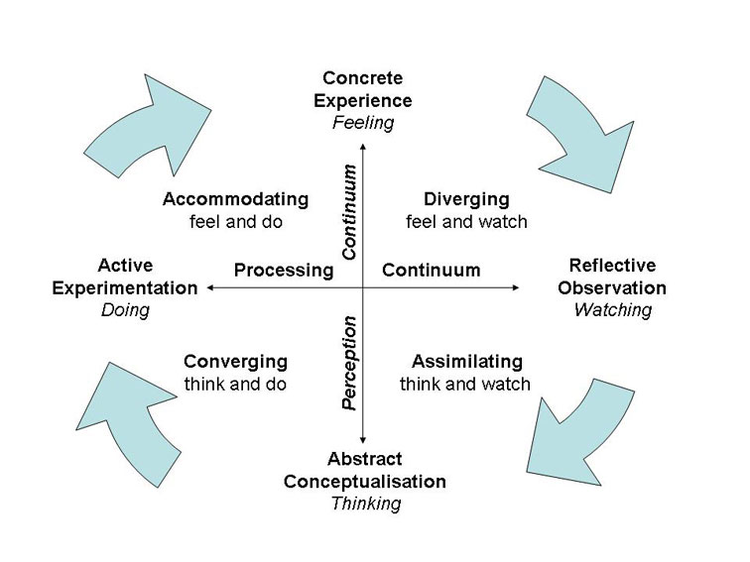
“Flipping” the Learning Process
Notes:
Concrete Experience
We see, smell, feel, touch, taste and hear it.
Reflective Observation
In order to be most effective, after the experience our next stop is to think about it:
What did I see, what did I hear, and what did I feel? We use that time for reflection and solitary activity.
Abstract Conceptualization
Based on our reflection we begin to develop a model in our minds about how the world works based upon what we just experienced.
How it all fits together and connects to other experiences I may have had.
We may think how to best assess the needs of the organization. How will change in one area affect another? What is the best intervention for the needs of this client system?
Active Participation
As with all theory, it is not useful until it is put into practice.
So the last stop on the train is Active participation. That is where you jump in and implement it to determine if your theory is right.

Slide 6
Examples of Non- Interactive Learning Assets
Recorded videos
Faculty / School produced
External sources (e.g., You Tube)
Online library resources
eBooks

Slide 7
Making Assets Accessible
Lessons Learned
Creating accessible assets from the beginning
Remediating assets
Transcripts & Closed Captions
Linking to publisher’s websites

Slide 8
Storing, Cataloging, & Sharing Learning Assets
Storage Decisions
Organizing Decisions
Sharing Decisions

Slide 9
Interactive Asynchronous & Synchonous Activities
Discussion Boards
Google Jamboard
Virtual Reality
Card Sort
Google Jamboard
Interactive Videos
Matching
Thinglink
Drag-n-Drop
Etc.

Slide 10
Revisioning the generalist curriculum
Bring the community into the learning space.
More interactive& collaborative space.
Support learning skills in a low stakes environment

Slide 11
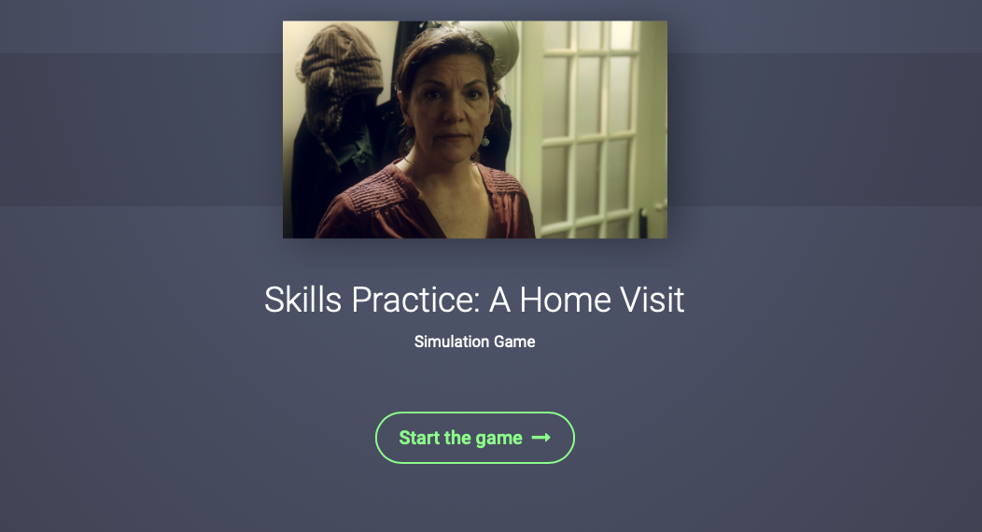
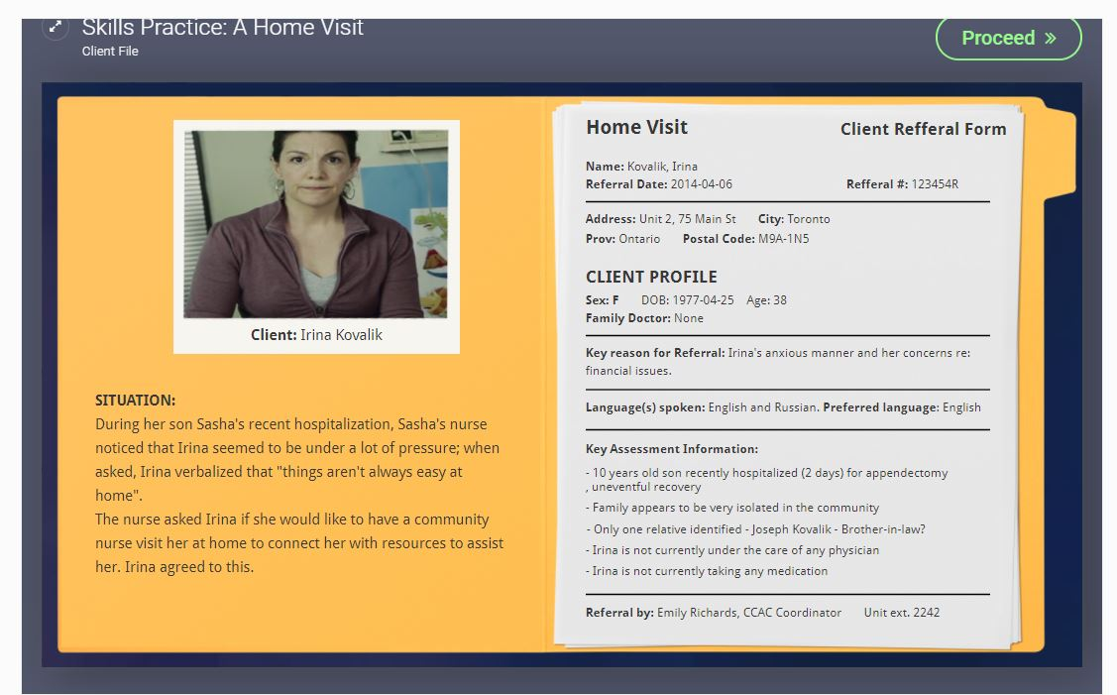
Branching Video (using H5P)

Slide 12
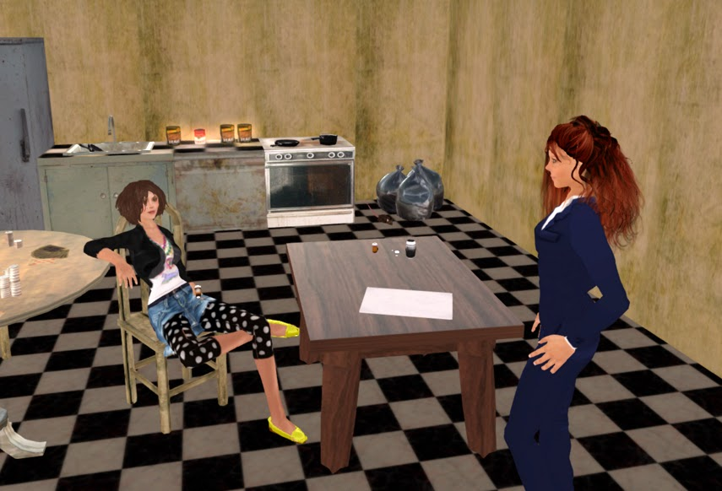
Virtual Reality – Second Life

Slide 13
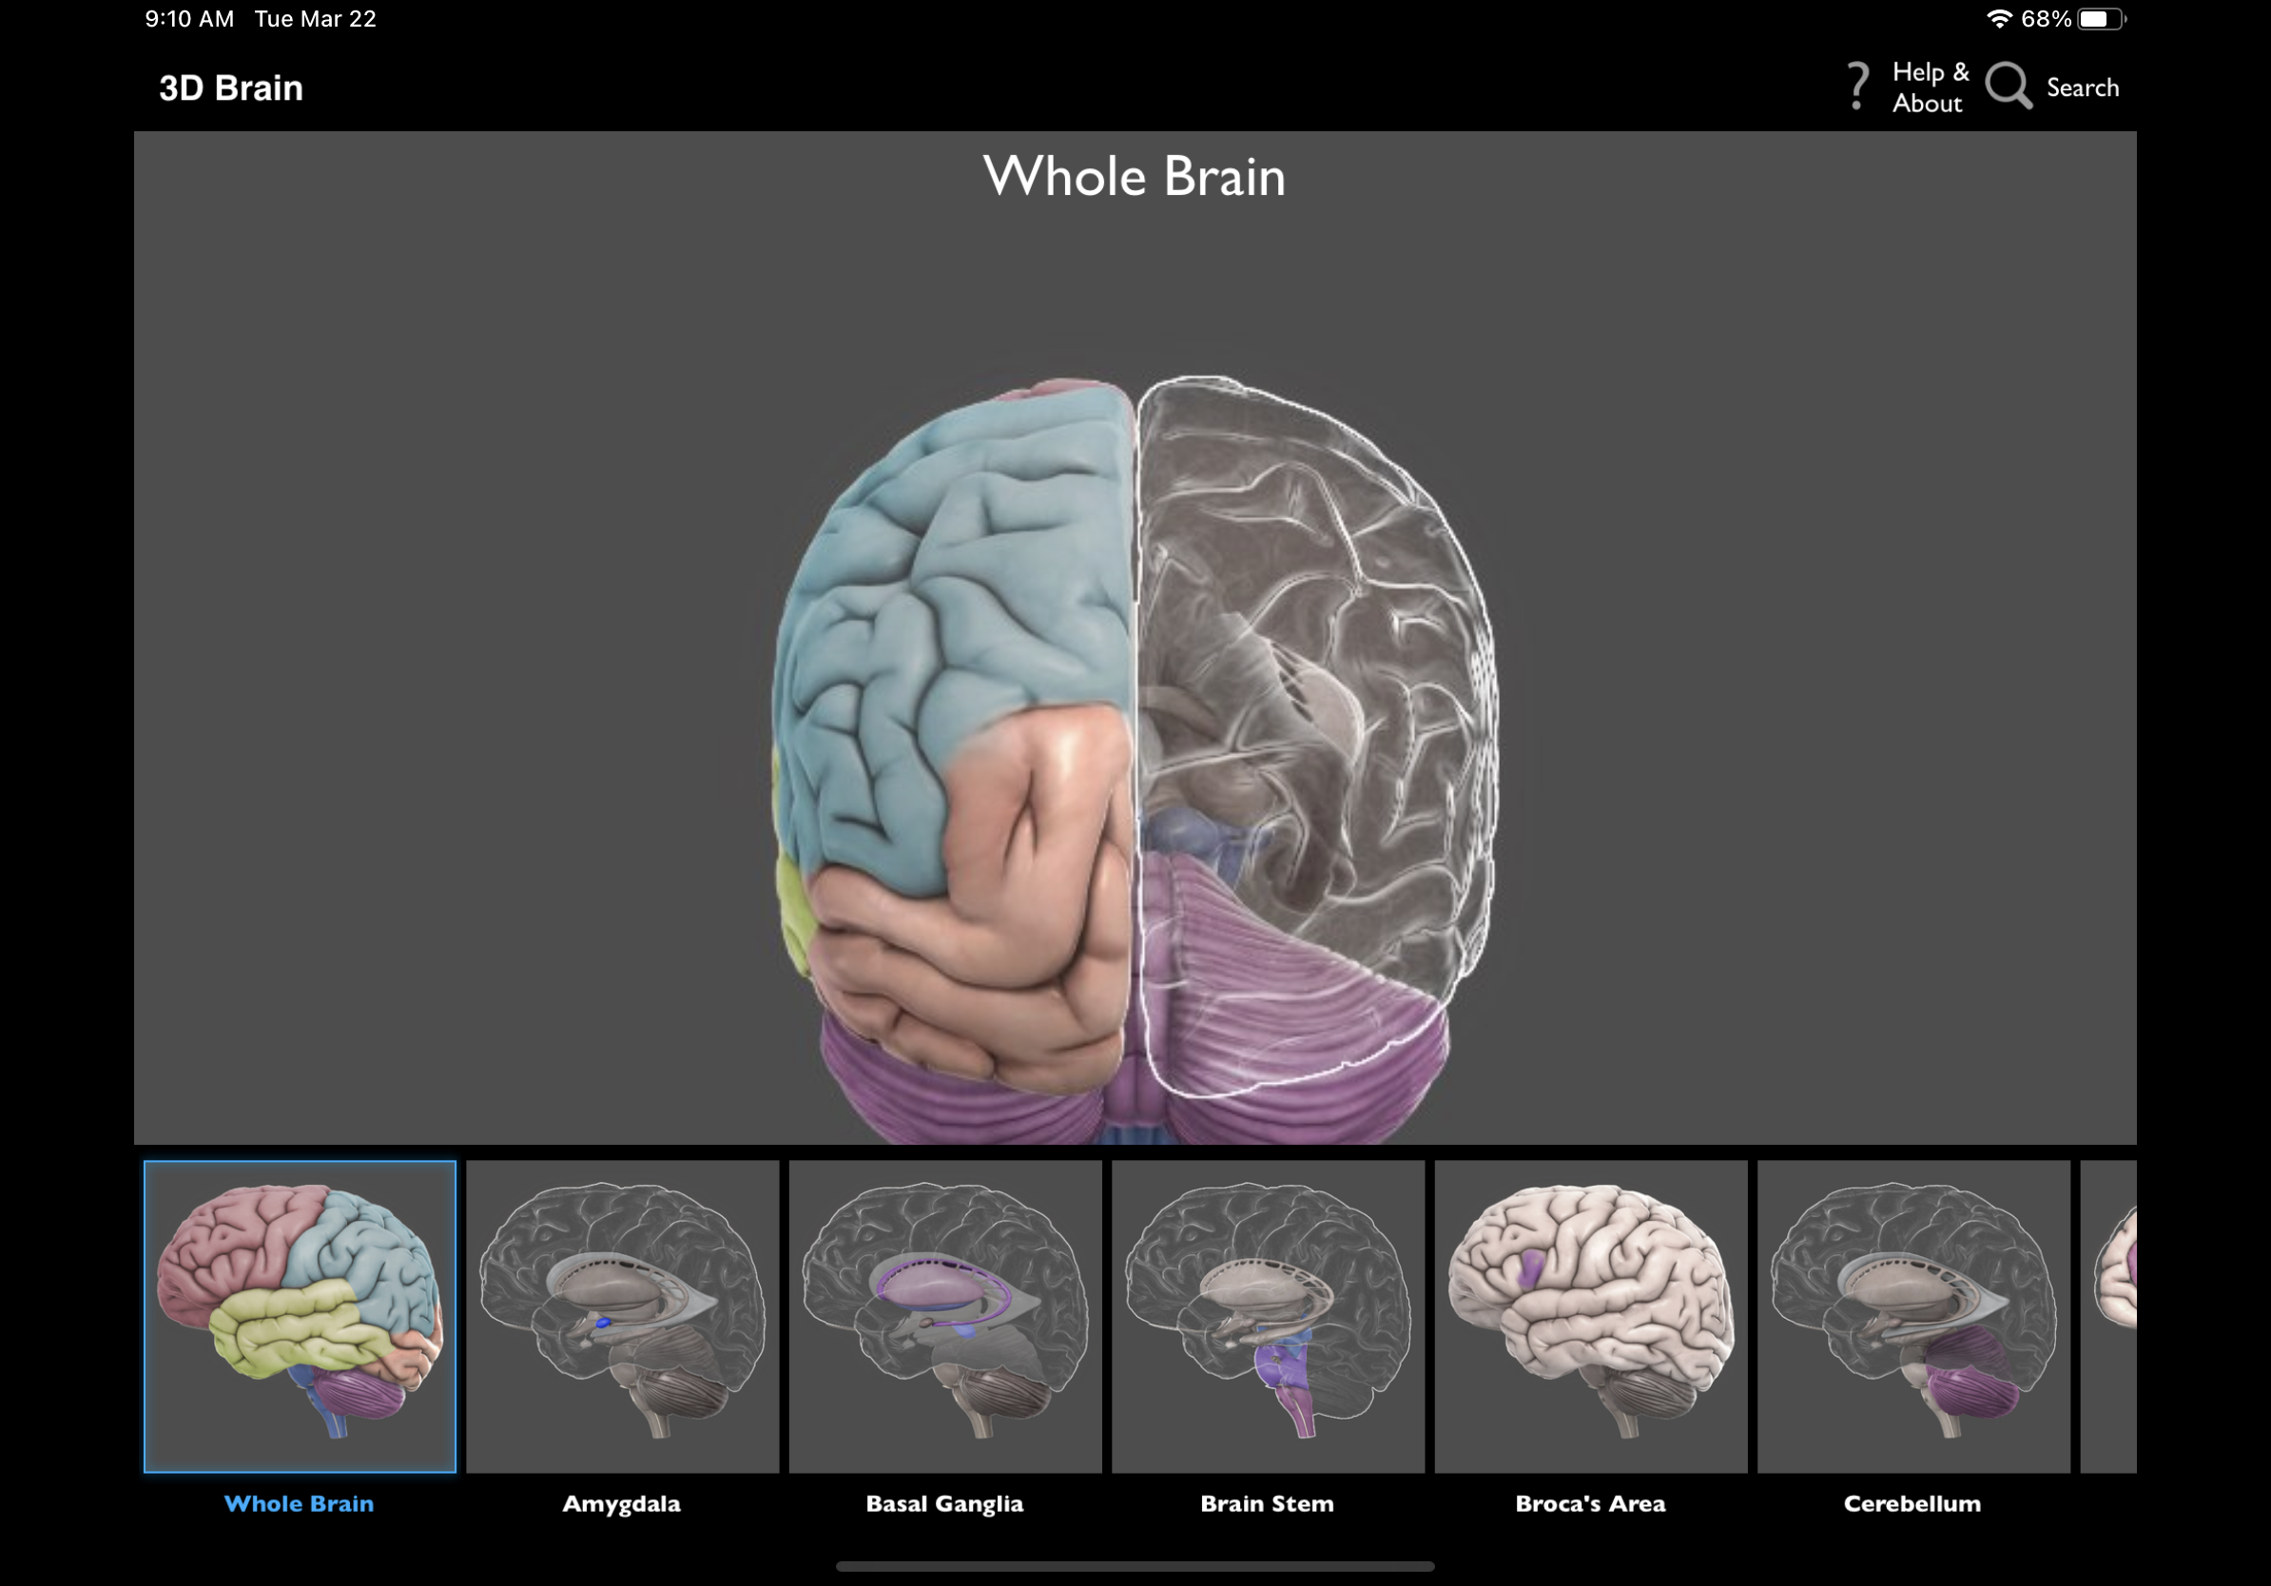
Learning Apps.
3D brain
Child development
0-6
Medscape
Mindfulness coach
PTSD coach
PTSD family coach
Exhale

Slide 14
Small group discussion
What digital learning assets do you use now?
How might digital learning assets enhance your teaching?
What resources would you need? (be sure to check out the Resource List)
Identify one strategy you might be able to use in an upcoming class.

Slide 15
Thank you!!
Marji Edguer, PhD, LISW-S, LICDC-CS
mxe@case.edu
Zoe Breen Wood, PhD, MSW
zbw@case.edu

