Slide 1
Critical Dialogues: Using art to address sexism, racism, and classism in substance use disorder treatment
Speakers
Rogério M. Pinto, PhD, LCSW, Professor, University of Michigan, Social Work
University Diversity Social Transformation Professor, University of Michigan, Social Work
Berit Ingersoll-Dayton Collegiate Professor, University of Michigan, Social Work
Professor of Theatre and Drama, University of Michigan School of Music, Theatre & Dance
Darris Hawkins, Peer Facilitator and Research Assistant.
North Jersey Community Research Initiative
Moderator: Liliane Windsor, PhD, MSW (lwindsor@illinois.edu)
Professor of Social Work and Associate Dean for Research.
School of Social Work, University of Illinois Urbana Champaign
March 4, 2024

Slide 2
Housekeeping
This event is brought to you by the Providers Clinical Support System – Medications for Opioid Use Disorders (PCSS-MOUD). Content and discussions during this event are prohibited from promoting or selling products or services that serve professional or financial interests of any kind.
The overarching goal of PCSS-MOUD is to increase healthcare professionals' knowledge, skills, and confidence in providing evidence-based practices in the prevention, treatment, recovery, and harm reduction of OUD.

Slide 3
Disclosures
Nothing to declare
The content of this activity may include discussion of off label or investigative drug uses. The faculty is aware that is their responsibility to disclose this information.

Slide 4
Educational Objectives
At the conclusion of this activity participants should be able to:
Describe how art and art-making can be used in critical dialogue to address sexism, racism, and classism to help treat substance use disorders
Identify how peer facilitators can incorporate art and critical dialogue in their practice
Describe how people with substance use disorders experience art and critical dialogue in treatment

Slide 5
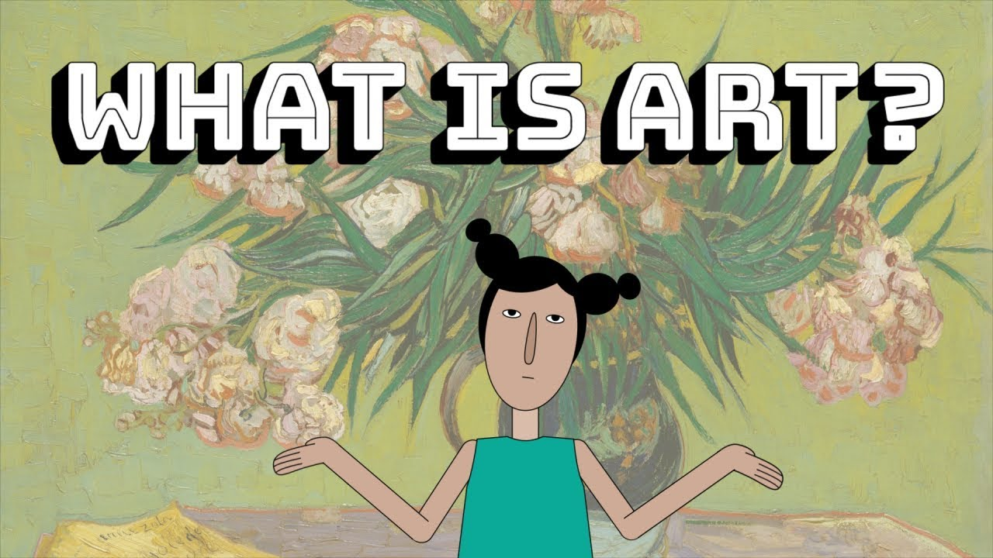
But I’m not an artist…
Notes:
Ask audience to define art – what is it? How is it used? How does it move them? Does it tell a story? What do we learn from it?

Slide 6
Art forms: image, music, drama, dance & ?
Subjective experiences of a person-in environment.
Notes:
Ask audience to define art – what is it? How is it used? How does it move them? Does it tell a story? What do we learn from it?

Slide 7
Art forms…
Image
Music
Drama
Dance
Videos
Photography
Drawing
Painting
Storytelling

Slide 8
Why use “art” to treat substance use disorders
Art equalize power differentials between client and practitioner
Creating art-based artifacts as a method allows clients to self-express in ways no other practices can.
Clients’ art-making allows them to define and redefine the type of outcome they seek – sobriety, harm reduction, etc.
Art can bring new meanings and perspectives into day-to-day practices
Difficult life experiences – incarceration, domestic violence, rape, child abuse – can be expressed through art (prevention of secondary trauma)
Differences in language and culture make interviewing and talk therapies less effective. Drawing, dance/move, singing, etc. to express difficult life experiences

Slide 9
Art in cognitive behavioral interventions
Community Wise (National Institute of Minority Health and Health Disparities (PIs: Windsor & Benoit; Co-I: Pinto - U01 MD010629)
To decrease substance-use by raising critical consciousness and addressing internalized oppression
Illustrations created by Christopher Burkle (in collaboration)
Each image depicts different sets of oppressive forces
Through critical dialogues, participants challenge oppression as depicted in the illustrations
Critical questions used to foster reflection on assumptions and beliefs indicative of internalized oppression
Critical consciousness = Reflection + Action (More about action at the end)

Slide 10
Solar System: To explore the different types of resources and socioeconomic threats to critical consciousness.
♦What do you see in this illustration?
♦What are the meteors around the sun representing?
♦How can you avoid the threats?
♦Are the resources always accessible to you? How do you know?
♦Who benefits/loses from the resources in your community?

Slide 11
Funhouse Mirrors: To learn about internalized oppression and how one’s own behaviors may contribute to their own oppression.

Slide 12
Walls: To increase participants’ awareness about the different mechanisms of oppression in contemporary society.

Slide 13
Historical Trauma: To increase awareness about how history impacts people’s behavior today.

Slide 14
Families & Relationships: To increase participants’ awareness about mainstream family ideals and the challenges people face trying to live up to such standards.

Slide 15
Boy and Girls, and…: To develop awareness about sexism, homophobia, and transphobia

Slide 16
Recap: More reasons for using “art”
Unearth dialogues about sexism, racism, and classism
Inspire critical dialogue and validate life experiences
Empower individuals to express themselves around emotional issues
Improve health outcomes among minoritized/marginalized groups
Generate critical consciousness: Reflection and social action

Slide 17
Art for social action
Critical reflection (Illustrations)
AND
Artifacts created by clients can be displayed and/or performed
Using images, music, and other artifacts to influence decision-makers – policies and practices
Creating a vehicle to influence public opinion and policy direction
Spark motivation, cognitive change, and advocacy.
Foster social engagement to combat oppression
Spark political advocacy and civic activities (e.g., writing letters to elected officials, volunteering at a community organization).

Slide 18
Intervention Delivery
Professional social workers
Peer facilitators
Any differences?
Mr. Darris Hawkins: His experience delivering Community Wise

Slide 19
References
Jemal, A., Windsor, L., Inyang, C., & Pierre-Noel, C. (2022) The critical dialogue cornerstone: Suggested Practices to guide implementation, facilitation and evaluation. Journal of Progressive Human Services: Radical Thought & Praxis. DOI: doi.org/10.1080/10428232.2022.2056866 NIHMS1794814
The Critical Consciousness Collaborative (2024). www.the3c.org
Windsor, L.; Benoit, E., Smith, D., Pinto, R. M., & Kugler, K. (2018) Optimizing a community-engaged multi-level group intervention to reduce substance use: An application of the multiphase optimization strategy. Trials, 19 (255). DOI: 10.1186/s13063-018-2624-5. PMC5921441
*Windsor, L.; Pinto, R.; Benoit, E.; Jessell, L., & Jemal, A. (2014). Community Wise: Addressing oppression to promote individual and community health. Journal of Social Work Practice in the Addictions, 14(4), 402-420.
Windsor, L., Benoit, E., & Jemal, A. (2014). Community Wise: Paving the Way for Empowerment in Community Reentry. International Journal of Law and Psychiatry. DOI 10.1016/j.ijlp.2014.02.023. NIHMS576112

Slide 20
PCSS-MOUD Mentoring Program
PCSS-MOUD Mentor Program is designed to offer general information to clinicians about evidence-based clinical practices in prescribing medications for opioid use disorder.
PCSS-MOUD Mentors are a national network of providers with expertise in addictions, pain, and evidence-based treatment including medications for opioid use disorder (MOUD).
3-tiered approach allows every mentor/mentee relationship to be unique and catered to the specific needs of the mentee.
No cost.
For more information visit:
https://pcssNOW.org/mentoring/

Slide 21
PCSS-MOUD Discussion Forum
Have a clinical question?
Ask a Colleague
A simple and direct way to receive an answer related to medications for opioid use disorder. Designed to provide a prompt response to simple practice-related questions.
http://pcss.invisionzone.com/register

Slide 22
PCSS-MOUD is a collaborative effort led by the American Academy of Addiction Psychiatry (AAAP) in partnership with:
_________________________________________
Addiction Policy Forum | American College of Medical Toxicology
Addiction Technology Transfer Center* | American Dental Association
African American Behavioral Health Center of Excellence | American Medical Association*
American Academy of Addiction Psychiatry* | American Orthopedic Association
American Academy of Child and Adolescent Psychiatry | American Osteopathic Academy of Addiction Medicine*
American Academy of Family Physicians | American Pharmacists Association*
American Academy of Neurology | American Psychiatric Association*
American Academy of Pain Medicine | American Psychiatric Nurses Association*
American Academy of Pediatrics* | American Society for Pain Management Nursing
American Association for the Treatment of Opioid Dependence | American Society of Addiction Medicine*
American Association of Nurse Practitioners | Association for Multidisciplinary Education and Research in Substance Use and Addiction*
American Chronic Pain Association | Coalition of Physician Education
American College of Emergency Physicians* | College of Psychiatric and Neurologic Pharmacists
 | Black Faces Black Voices

Slide 23
PCSS-MOUD is a collaborative effort led by the American Academy of Addiction Psychiatry (AAAP) in partnership with:
_________________________________________
Columbia University, Department of Psychiatry* | Partnership for Drug-Free Kids
Council on Social Work Education* | Physician Assistant Education Association
Faces and Voices of Recovery | Project Lazarus
Medscape | Public Health Foundation (TRAIN Learning Network)
NAADAC Association for Addiction Professionals* | Sickle Cell Adult Provider Network
National Alliance for HIV Education and Workforce Development | Society for Academic Emergency Medicine*
National Association of Community Health Centers | Society of General Internal Medicine
National Association of Drug Court Professionals | Society of Teachers of Family Medicine
National Association of Social Workers* | The National Judicial College
National Council for Mental Wellbeing* | Veterans Health Administration
National Council of State Boards of Nursing | Voices Project
National Institute of Drug Abuse Clinical Trials Network | World Psychiatric Association
Northwest Portland Area Indian Health Board | Young People In Recovery

Slide 24
Educate. Train. Mentor
@PCSSProjects
www.pcssNOW.org
www.facebook.com/pcssprojects/
pcss@aaap.org
Funding for this initiative was made possible (in part) by grant no. 1H79TI086770 from SAMHSA. The views expressed in written conference materials or publications and by speakers and moderators do not necessarily reflect the official policies of the Department of Health and Human Services; nor does mention of trade names, commercial practices, or organizations imply endorsement by the U.S. Government.

